Slide 1
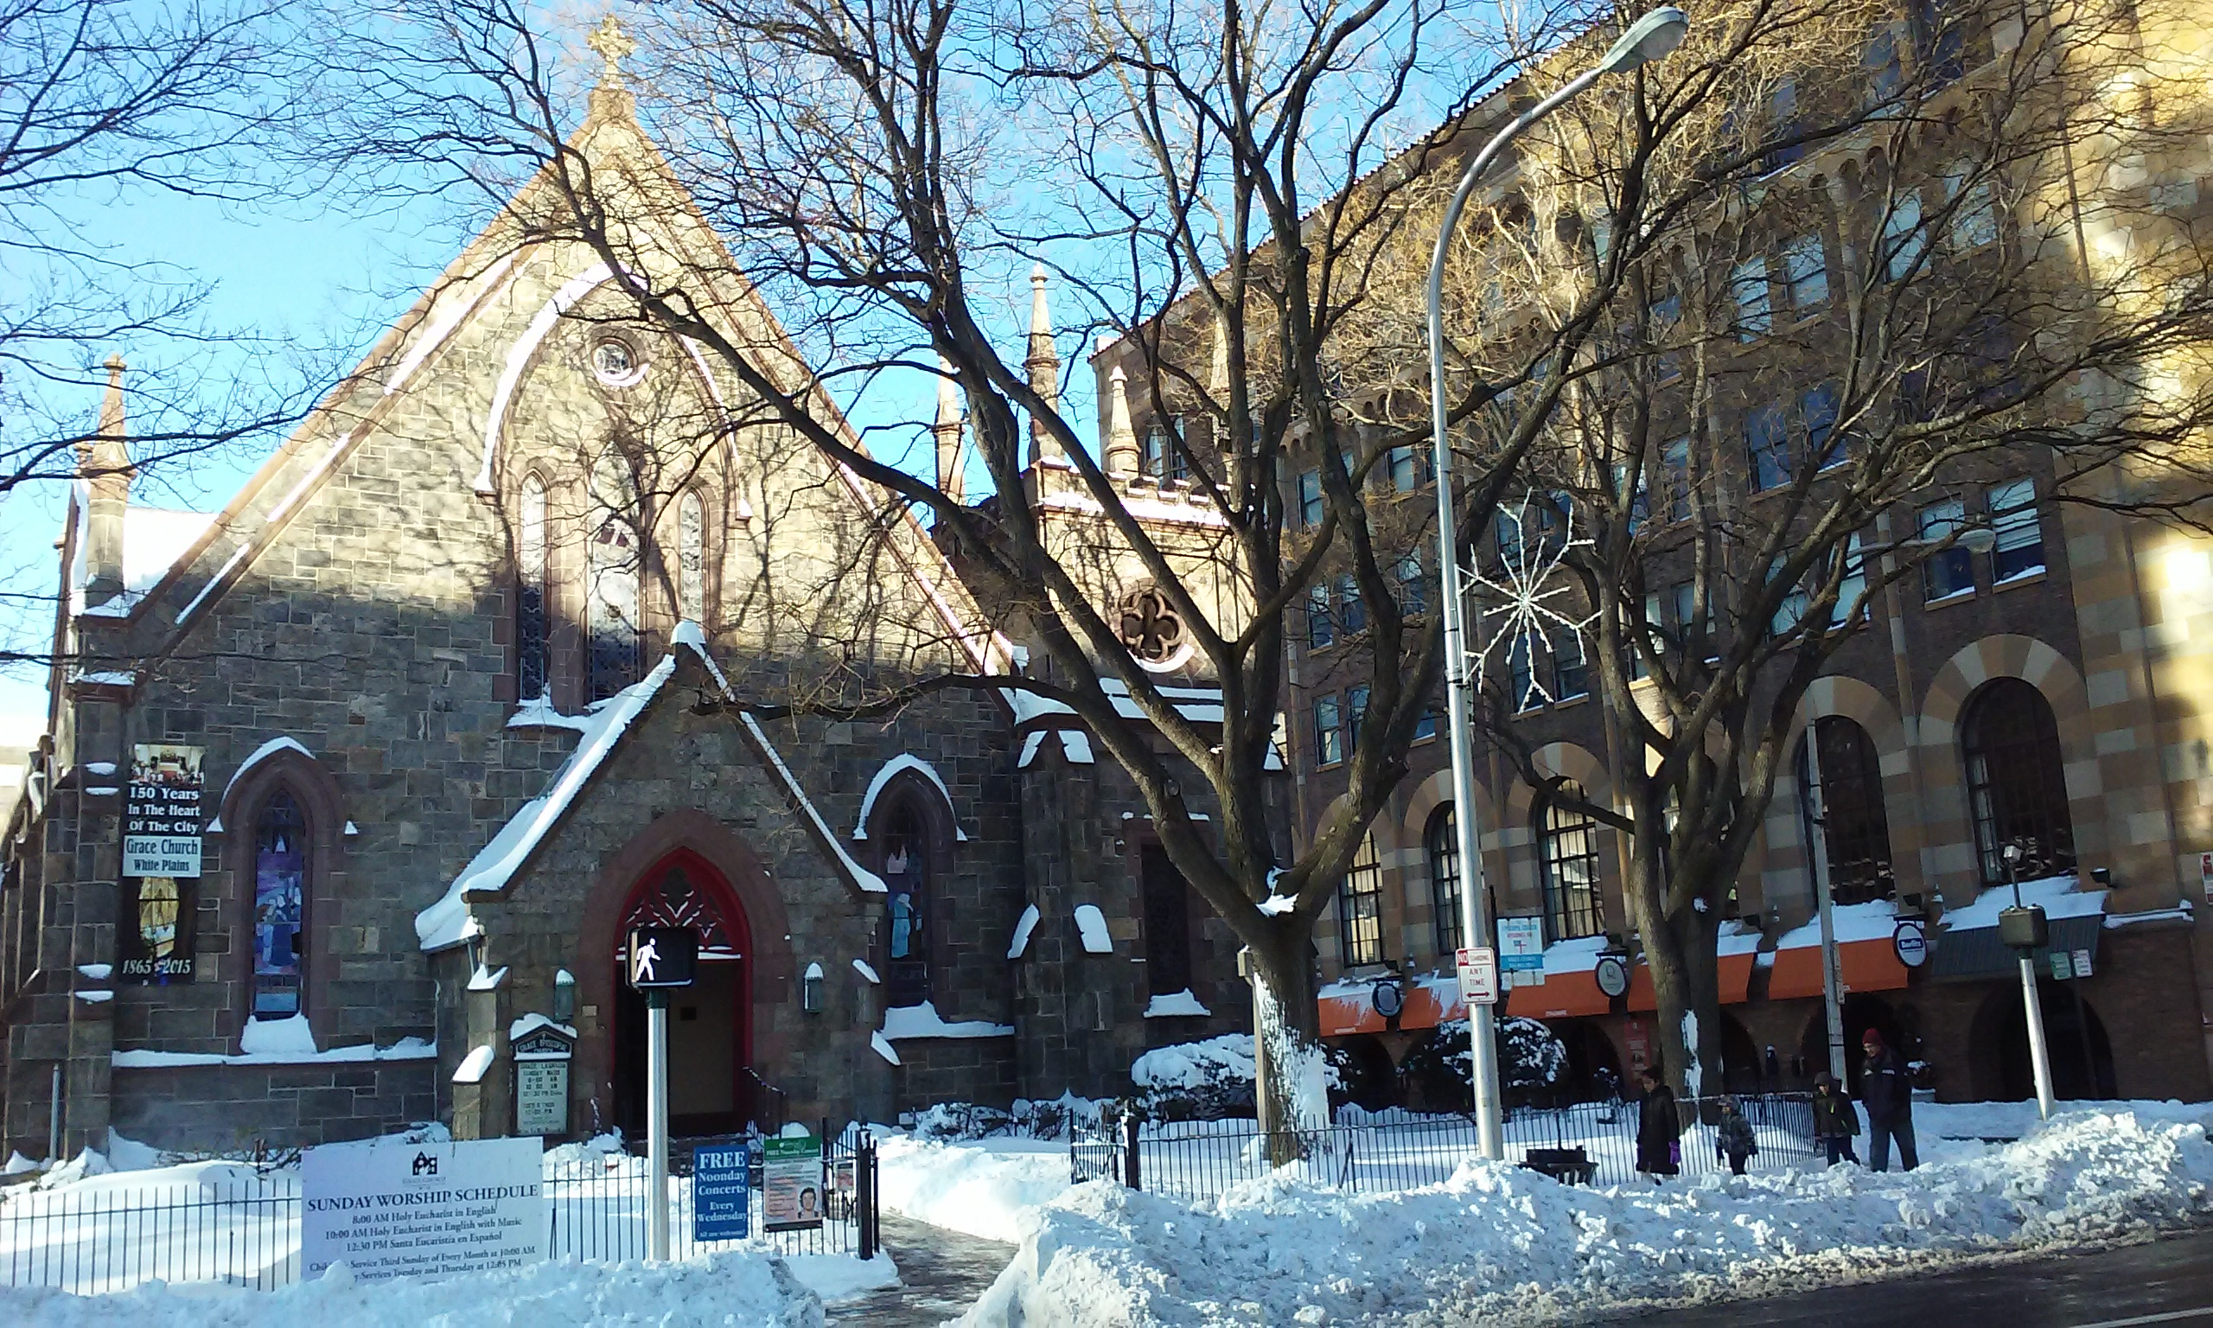
Grace Church, White Plains
Grace Church
Annual Meeting
January 31, 2016

Slide 14
 | Grace Church/La Gracia Memorial Walkway Fundraising
Stone Style | Donation per donor | # donors per stone | Total donation per stone | Less engraving cost | Less cost to transport stones | Net contribution per stone |  | Est # stones sold |  | Total est net contributions
Full (max 3 lines) | $ 400 | 1 | $ 400 | $ 150 | $ 10 | $ 240 |  | 20 |  | $ 4,800
Half (max 2 lines) | $ 225 | 2 | $ 450 | $ 200 | $ 10 | $ 240 |  | 30 |  | $ 7,200
Name in list | $ 100 | 5 | $ 500 | $ 300 | $ 10 | $ 190 |  | 6 |  | $ 1,140
TOTAL |  |  |  |  |  |  |  | 56 |  | $ 13,140

Slide 15
 | Planned Improvements
 | Sprinkler System* |  | $ 4,250
 | Replace front bushes |  | $ 2,250
 | Back corner fence |  | $ 900
 | Two 150th stones |  | $ 500
 | Cappelli Memorial |  | $ 150
 | Cappelli engraving reimbusment |  | $ (150)
 | Paint fence |  | $ 2,000
 | TOTAL |  | $ 9,900
 | *Already committed

Slide 19
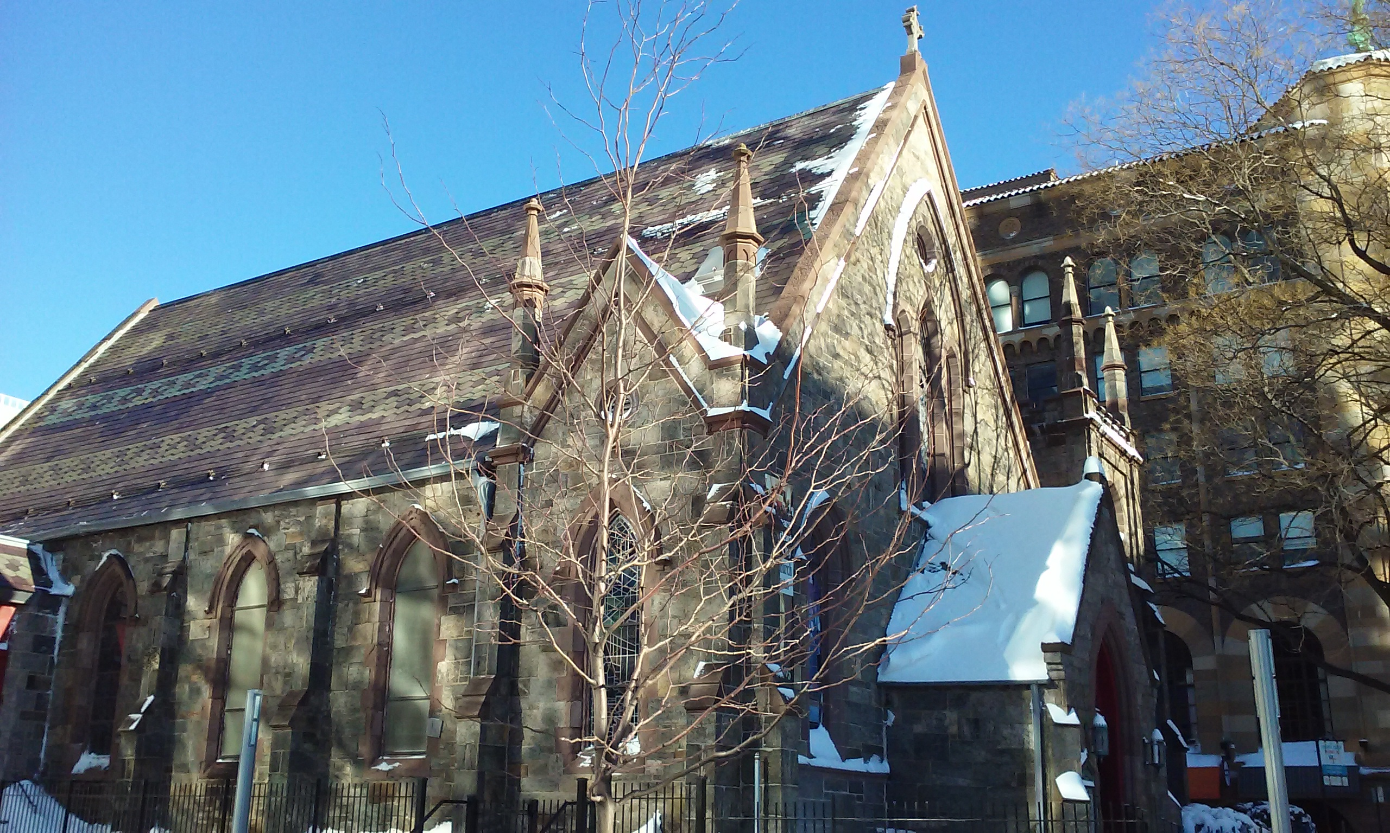
“And now faith, hope and love abide, these three; but the greatest of these is love.”
Grace Church, White Plains
Annual Meeting
January 31, 2016

